Slide 1
Head-wise Shareable Attention for Large Language Models
${Zouying Cao}^{1,2,3}$, ${Yifei Yang}^{1,2,3}$, ${Hai Zhao}^{1,2,3,∗}$ $^{1}$Department of Computer Science and Engineering, Shanghai Jiao Tong University
$^{2}$Key Laboratory of Shanghai Education Commission for Intelligent Interaction
and Cognitive Engineering, Shanghai Jiao Tong University
$^{3}$Shanghai Key Laboratory of Trusted Data Circulation and Governance in Web3
{zouyingcao,yifeiyang}@sjtu.edu.cn, zhaohai@cs.sjtu.edu.cn
The 2024 Conference on Empirical Methods in Natural Language Processing November 12-16, Miami, Florida
https://arxiv.org/pdf/2402.11819
Notes:
Hi everyone, my name is Cao Zouying. I’m currently a master student majoring in computer science and technology in Shanghai Jiao Tong University, China. Today, I will introduce our paper Head-wise Shareable Attention for Large Language Models
[c]
from the following four parts.

Slide 2
Outline
Introduction
Motivation
Methodology
Experiments

Slide 3
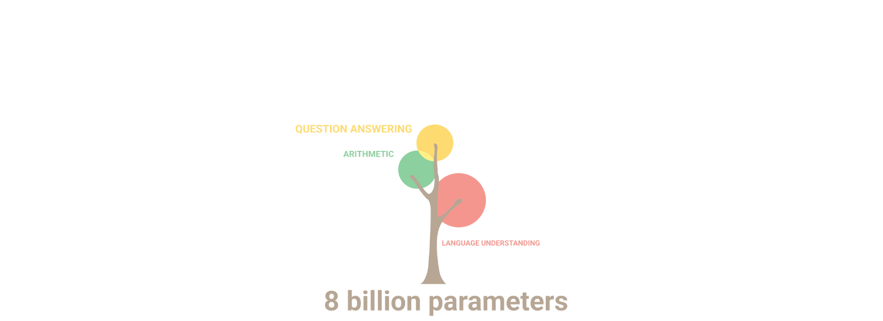
Introduction
GPT-4
LLaMA
…
Resource-hungry
Network Compression Methods
Two Key Challenges:
Choice of shared modules whose weights are reused
Trade-off between reducing GPU memory and preserving model performance
① model pruning
works well for LLMs
requires post-training
② weight sharing
mainly for small models
layer-wise sharing rules
Can we design one fine-grained weight sharing strategy that can smoothly apply to LLMs?
Ref: http://research.google/blog/pathways-language-model-palm-scaling-to-540-billion-parameters-for-breakthrough-performance/
Notes:
Recently, large language models such as GPT-4, LLaMA and more have achieved breakthrough performance in a variety of natural language processing tasks. [C] However, such remarkable capability/ˌkeɪpəˈbɪləti/ typically comes at the cost of a substantial increase in the model size. [C]
Thus, it poses challenges for deployment on devices with limited storage and GPU memory. [C]
To address the high memory requirements of models, several network compression methods are proposed. [C]
One popular domain is called model pruning. It drops subset of the network weights, mostly by setting part of the model weights to zero, while trying to preserve model quality. However, this kind of method usually requires some sort of post-training, which is costly for LLMs. [C]
Another domain is weight sharing that encourages weight reuse to achieve memory- and storage-efficiency while preserving model performance. This method is simple and proved to be successful for smaller models with little retraining. However, current weight sharing techniques primarily focus on small-scale models like BERT. Therefore, the effectiveness of similar techniques at the scale of LLMs remains uncertain. Moreover, their focus is mainly on layer-wise sharing rules. [C]
Recent researches demonstrate identical weights across different layers are the main cause of performance degradation/ˌdeɡrəˈdeɪʃn/. Inspired by this, we come up with one question: Can we design one fine-grained weight sharing strategy that can smoothly apply to large language models ? Here, our work was born. [C]
Before we dive into details, let’s look at two key challenges must be tackled for one effective weight sharing method tailored to LLMs:
First, the choice of shared modules whose weights are reused;
Second, the tradeoff between reducing GPU memory and preserving model performance.

Slide 4
Outline
Introduction
Motivation
Methodology
Experiments
Notes:
So, here comes the motivation of our paper work.

Slide 5
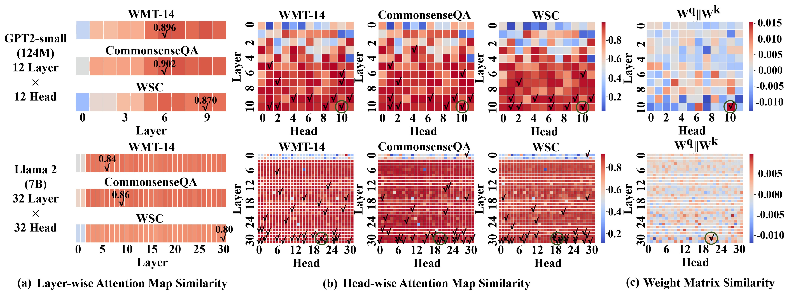
Attention Map Similarity: From Layer-wise to Head-wise
The degrees of similarity in attention scores computed in different layers and heads present a certain level of consistency across different tasks.
The cosine similarity values for pairs with high similarity are higher among different heads compared to layers.
Notes:
Prior/ˈpraɪər/ researches demonstrate the effectiveness of attention map reuse due to the high similarity of attention scores between different layers.
Motivated by this, we delve into attention map similarity, specifically/spəˈsɪfɪkli/ transitioning/trænˈzɪʃnɪŋ/ from layer-wise to head-wise analysis/əˈnæləsɪs/.
[c]
As shown in Fig. 1(a) and (b), the degrees of similarity in attention scores computed in different layers and heads present a certain level of consistency across different tasks. In addition, we find that the cosine similarity values for pairs with high similarity are higher among different heads compared to layers.

Slide 6
From Attention Map Similarity to Weight Matrix Similarity
The most similar weight matrix corresponds to the overlapping modules with highly similar attention maps observed across different datasets.
Attention heads with high weight matrix similarity demonstrate analogous attention map similarity regardless of the datasets and model size.
Notes:
Since the attention scores are calculated based on the weight matrices Wq, Wk, attention weight matrix similarity can provide a complementary/ˌkɑːmplɪˈmentri/ perspective to attention map similarity. As mentioned before, head-wise attention map similarity is higher than the cross-layer similarity, while to the best of our knowledge, head-wise attention map reuse is yet to be explored. This might be attributed to the difficulty in finding an optimal dynamic/daɪˈnæmɪk/ head-wise sharing strategy/ˈstrætədʒi/ across different tasks.
By concatenating/kənˈkætəˌneɪtɪŋ/ the weight matrix Wq and Wk for each head to measure the cosine similarity, we made a key discovery: the most similar weight matrix corresponds to the overlapping modules with highly similar attention maps observed across different datasets.
That is to say, attention heads with high weight matrix similarity demonstrate analogous/əˈnæləɡəs/ attention map similarity regardless of the datasets and model size.

Slide 7
Outline
Introduction
Motivation
Methodology
Experiments
Notes:
Thus, we further propose a simple yet effective method for head-wise weight sharing. Now I will introduce the methodology/ˌmeθəˈdɑːlədʒi/ part.

Slide 8
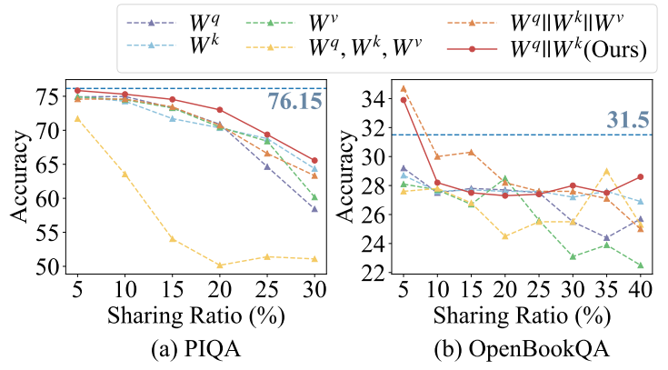
Head-wise Weight Sharing Strategy
Head-wise Match Function:
Intuitive Choice:
Ablation Study:
Notes:
We first perform preliminary/prɪˈlɪmɪneri/ experiments in the choice of head-wise match functions Match(·,·). For the match functions, inputs are the weight matrices/ˈmeɪtrɪsiːz/ of head pairs and outputs are called matching scores. The higher the score, the more likely it is to share parameters/pəˈræmɪtər/ across the heads.
Based on our intuitive/ɪnˈtuːɪtɪv/ analysis, we choose the cosine similarity between the concatenation matrix of Wq and Wk. Besides, we try another five match functions to compare. We just directly share weight matrices/ˈmeɪtrɪsiːz/ across different heads based on matching scores and the lower right figure shows the results of our ablation/əˈbleɪʃn/ study.
As evidenced, it is enough to do head-wise weight sharing focusing only on the concatenation matrix of Wq and Wk.

Slide 9
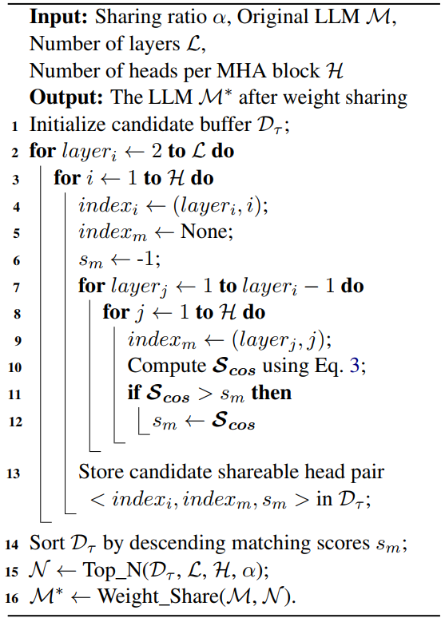
Head-wise Weight Sharing Strategy
Matching (line 1-13):
Prepare Candidate Pairs
Calculate Similarity
Weight Sharing (line 14-16):
Sort the Candidate Pairs
Select the Top-N Pairs for Sharing
DirectShare / PostShare
Notes:
Next, we traverse all head pairs to compute matching scores and for each head, select the one with the highest score to match. When candidate shareable head pairs prepared, we select the top-N pairs in descending/dɪˈsendɪŋ/ order according to the desired sharing ratio. Finally, we can share the weight matrices together between each selected attention head pairs. Our DirectShare and PostShare are two complementary methods based on this head-wise weight sharing strategy.

Slide 10
DirectShare & PostShare
DirectShare: for each selected head pair, keep the weight values of the head in former layer unchanged and select to change the weight values of the head in latter layer.
PostShare: softly align model weights via post-training, pushing selected weight matrices more similar. After the post-training process, the corresponding weight matrices can be shared as DirectShare does.
Notes:
DirectShare just directly keeps the weight values of the head in former layer unchanged and selects to change the weight values of the head in latter layer, resulting in the final model.
Although DirectShare demonstrates its effectiveness, we have also found performance drop in minor/ˈmaɪnər/ reading comprehension datasets.
To mitigate this problem, we propose PostShare, softly aligning model weights during the post-training process and then shares as DirectShare does.

Slide 11
Outline
Introduction
Motivation
Methodology
Experiments
Notes:
Now, let’s move on to the evaluation of our method.

Slide 12
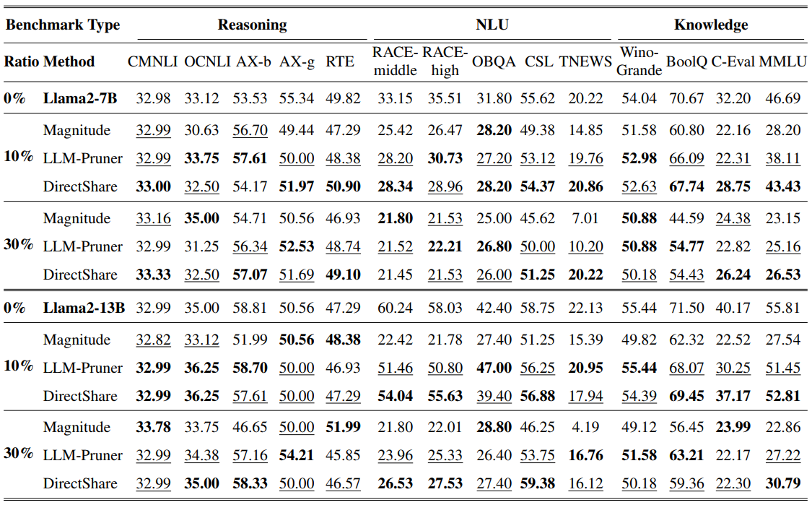
Evaluation on DirectShare
OpenCompass platform
Benchmarks are classified into three categories: reasoning, natural language understanding (NLU) and knowledge-related.
DirectShare achieves comparable performance to the competitive network pruning methods.
Notes:
For fair comparison/kəmˈpærɪsn/, we deploy OpenCompass to evaluate over three categories/ˈkætəˌgɔriz/: reasoning, natural language understanding and knowledge-related tasks.
Overall, DirectShare achieves comparable/ˈkɑːmpərəbl/ performance to the competitive/kəmˈpetətɪv/ network pruning methods.

Slide 13
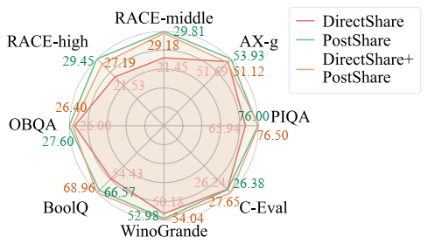
Evaluation on PostShare
Most of the gap between models after DirectShare and the original counterparts can be narrowed via PostShare.
Combine PostShare with DirectShare
Another interesting research finding is the combination of our DirectShare and PostShare, where PostShare can play a role in fast performance recovery for DirectShare.
Notes:
And PostShare achieves more stable and satisfactory performance when reducing memory usage, with the cost of time increase.
After combining PostShare with DirectShare, we found PostShare can play a role in fast performance recovery for DirectShare.

Slide 14
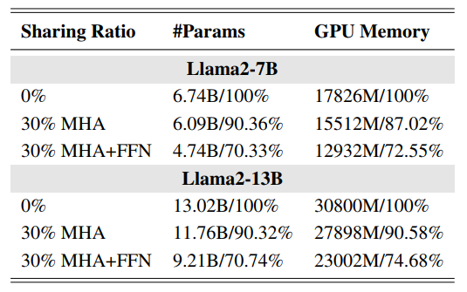
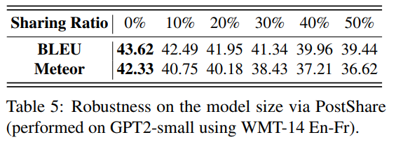
More Analysis
Statistics of Memory Reduction
When doing 30% parameter sharing in the MHA block, our method achieves 10-13% GPU memory reduction.
When we share 30% of parameter in both MHA and FFN block, the model can save 26-28% GPU memory.
Robustness on the Model Size
At a 50% sharing ratio, GPT-small via PostShare can still yield a BLEU score of 39.44.
Such kind of variance in performance is acceptable that to some degree proves our method is also suitable for small-scale models.
Notes:
We also record the statistics of the parameter/pəˈræmɪtər/ count and memory consumption when applying DirectShare. When doing 30% parameter/pəˈræmɪtər/ sharing in the Multi-Head Attention block, our method achieves 10-13% memory reduction. Moreover, we find our weight sharing strategy also applies to Feedback Forward Network block. Finally, when we share 30% of parameter/pəˈræmɪtər/ in both two blocks, the model can save 26-28% GPU memory.
We further validate the effectiveness of our method on smaller models like GPT2-small.

Slide 15
Outline
Introduction
Motivation
Methodology
Experiments
Conclusion

Slide 16
Thank you !
Q&A
Head-wise Shareable Attention for Large Language Models
https://github.com/zouyingcao/DirectShare
${Zouying Cao}^{1,2,3}$, ${Yifei Yang}^{1,2,3}$, ${Hai Zhao}^{1,2,3,∗}$ $^{1}$Department of Computer Science and Engineering, Shanghai Jiao Tong University
$^{2}$Key Laboratory of Shanghai Education Commission for Intelligent Interaction and Cognitive Engineering,
Shanghai Jiao Tong University
$^{3}$Shanghai Key Laboratory of Trusted Data Circulation and Governance in Web3
{zouyingcao,yifeiyang}@sjtu.edu.cn, zhaohai@cs.sjtu.edu.cn
Notes:
That’s all. Thanks for listening.
It’s my pleasure to share our work.
Thank you.

